Slide 1
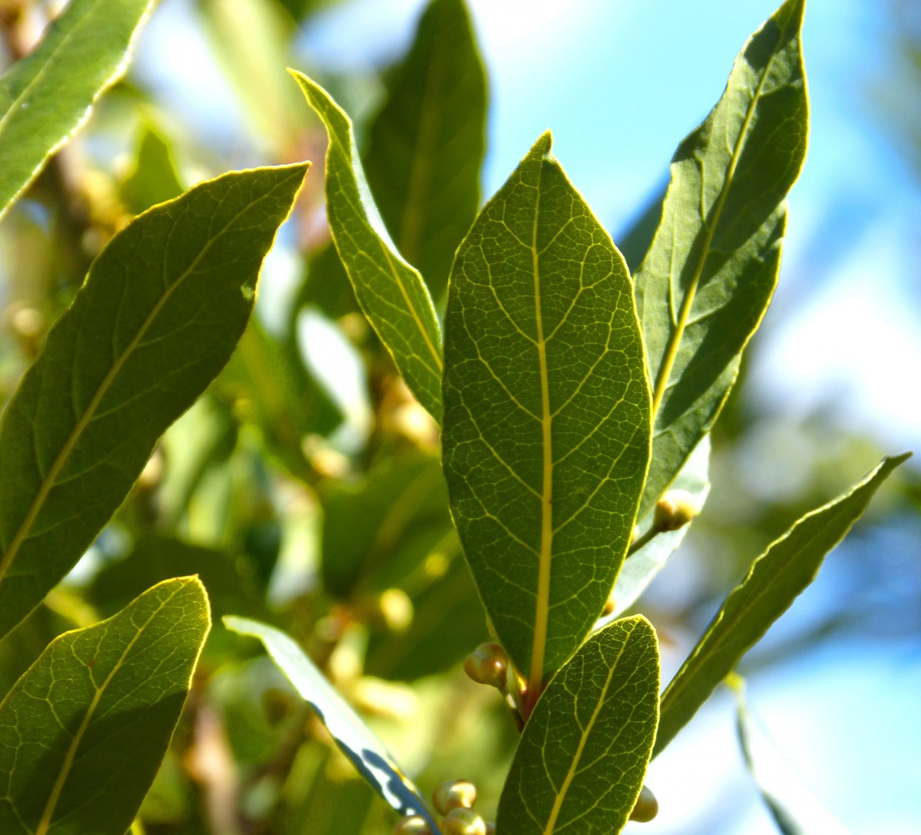

Plant Disease Classification Project Mentor: Sibi Manickam
By,
Akshaya Krishna p
Anindita Patnaik
Rachita J
Sayali Doifode
Vyshnavi KUNdula

Slide 2
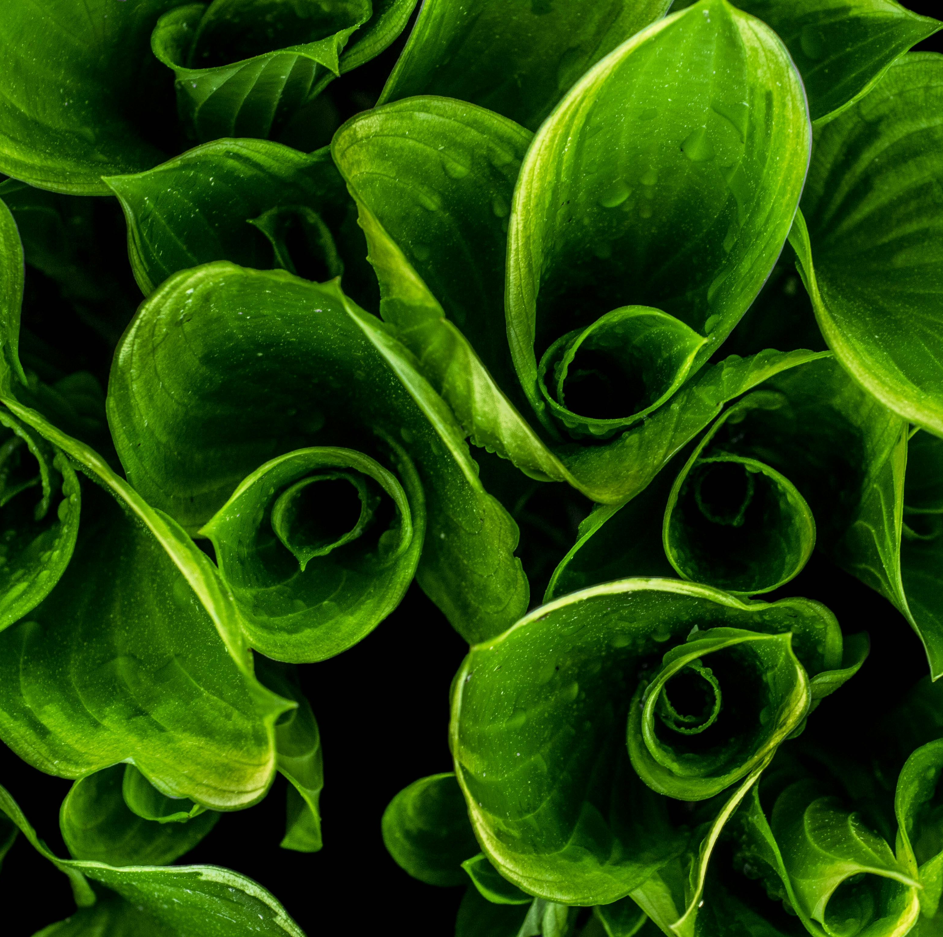
Introduction
In this presentation, we will explore advanced techniques for plant disease classification. We will discuss the latest methods and technologies used to accurately identify and classify plant diseases, leading to improved crop management and yield. Let's delve into the world of cutting-edge plant disease classification.

Slide 3

Importance of Disease Classification
Accurate disease classification is crucial for timely intervention and effective management of plant diseases. It enables early detection, targeted treatment, and prevention of widespread crop damage. Proper classification also facilitates research in disease-resistant crop development, contributing to sustainable agriculture.

Slide 4
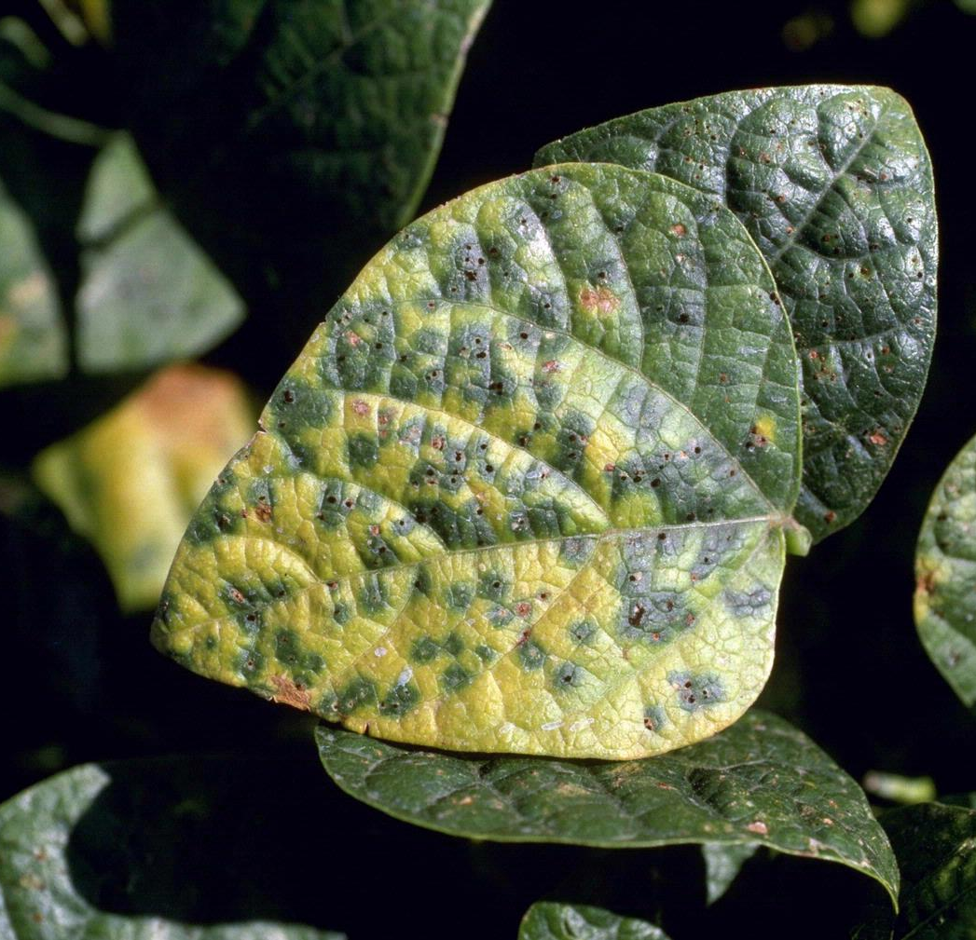
Challenges in Disease Identification
Identifying plant diseases accurately is challenging due to factors such as morphological variations and symptom overlap. Traditional methods often struggle to differentiate between similar-looking diseases, leading to misdiagnosis and ineffective treatments.
This Photo by Unknown Author is licensed under CC BY

Slide 5

Machine Learning in Disease Classification
Machine learning algorithms, particularly convolutional neural networks (CNNs), have revolutionized plant disease classification. By analyzing large datasets of plant images, CNNs can accurately identify diseases based on visual patterns, leading to rapid and reliable disease diagnosis.

Slide 6

Model Architecture

Slide 7
Model architecture basically consists of Pooling Layer, Convolutional Layer,Flatten (Vectorization),Fully-Connected Layers
Convolutional layers is used to detect features like edge, shape, pattern, etc
activation functions like ReLU is used to Add nonlinearity to increase the expressive power and convolution is a linear function
Pooling drastically reduce the shape of features
Flatten layer is typically used to transform the output from the convolutional and pooling layers into a one-dimensional vector. This is important because subsequent fully connected layers (dense layers) in the network expect input in this format.
Convolutional Layer 1
• Use multiple filters (kernels) for the feature mapping.
• Apply an activation function (e.g., ReLU).
• A Convolutional layer = convolution + activation.
Pooling Layer 1
• Pooling reduces the dimensionality of each feature map.
• E.g., Max Pooling, Average Pooling, etc.
Convolutional Layer 2
• Perform tensor convolution
Pooling Layer 2
can be used any type of pooling
Flatten (Vectorization)
• Flatten the tensor.
Fully-Connected Layers
• Add one or more fully-connected layers

Slide 8
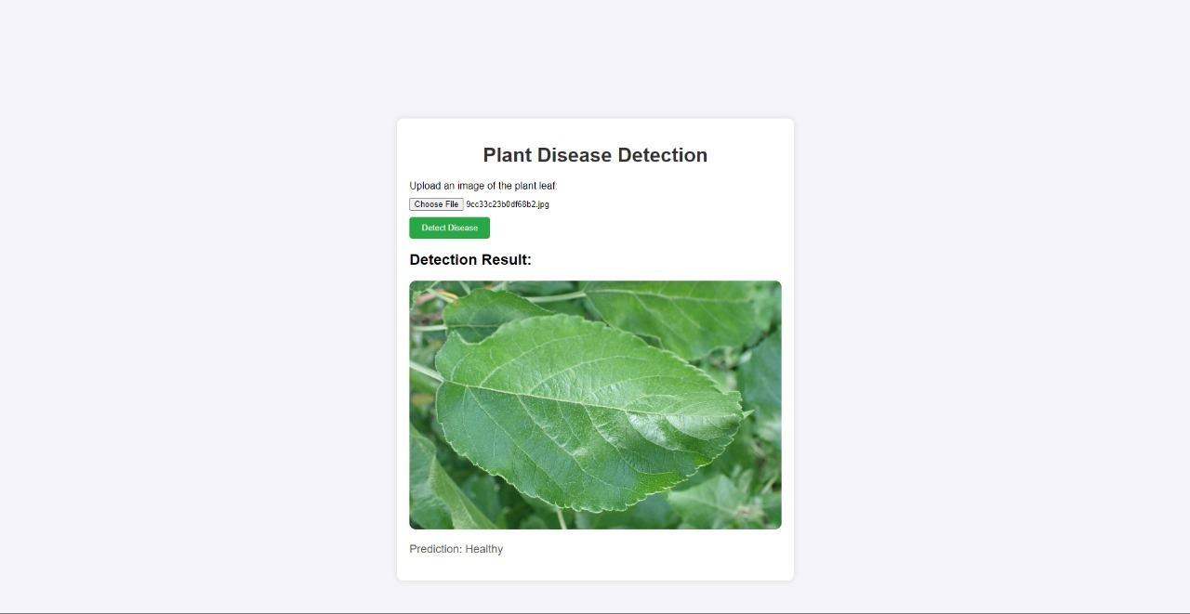
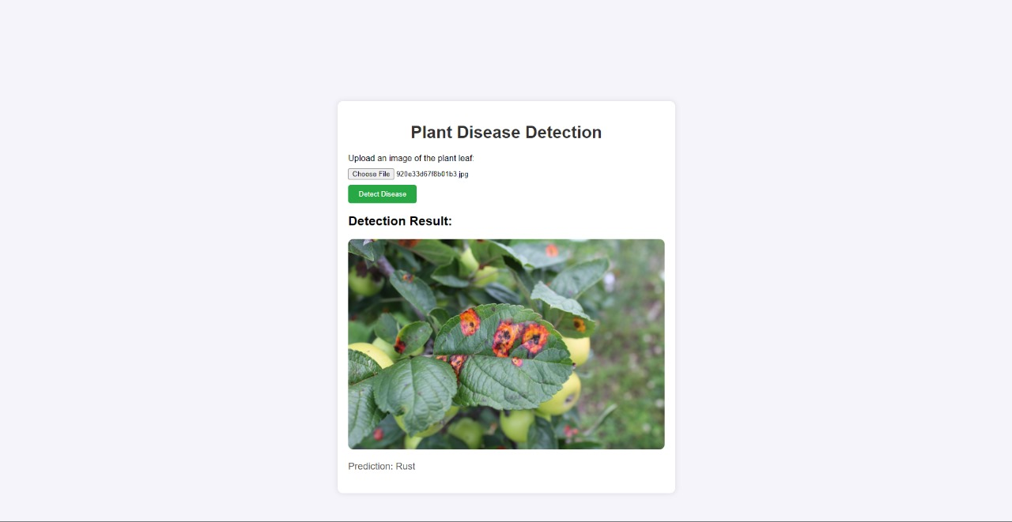
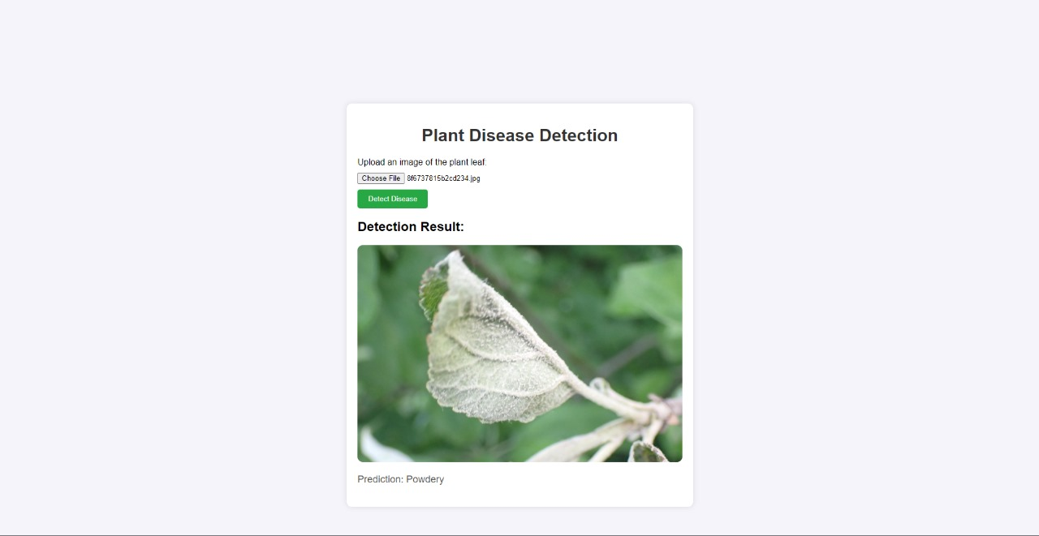
Model Outputs

Slide 9
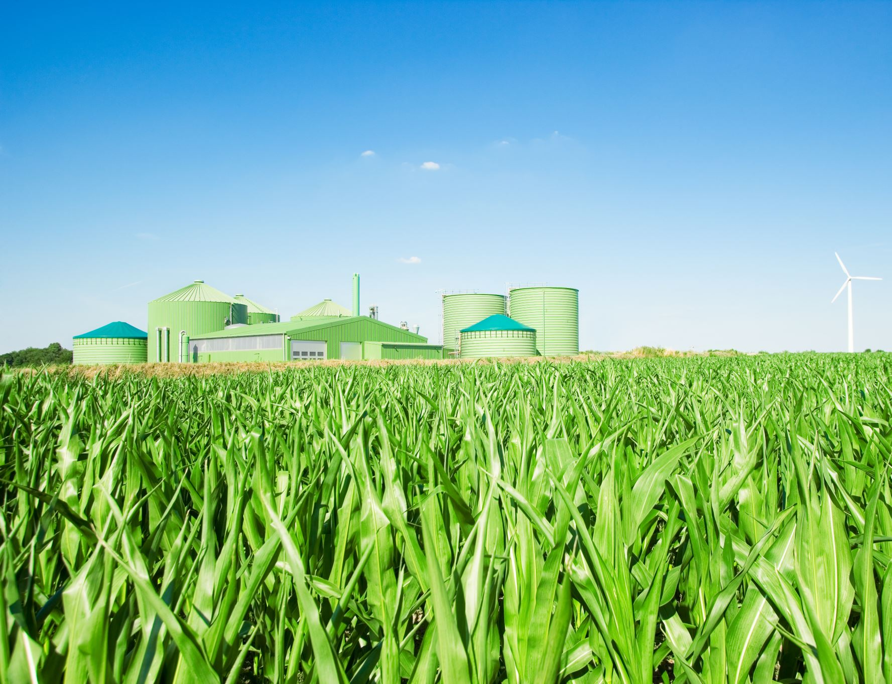
Future Implications and Applications
The advancements in plant disease classification have far-reaching implications, from ensuring global food security to promoting sustainable agricultural practices. These technologies pave the way for proactive disease management, precision agriculture, and the development of disease-resistant crop varieties.

Slide 10
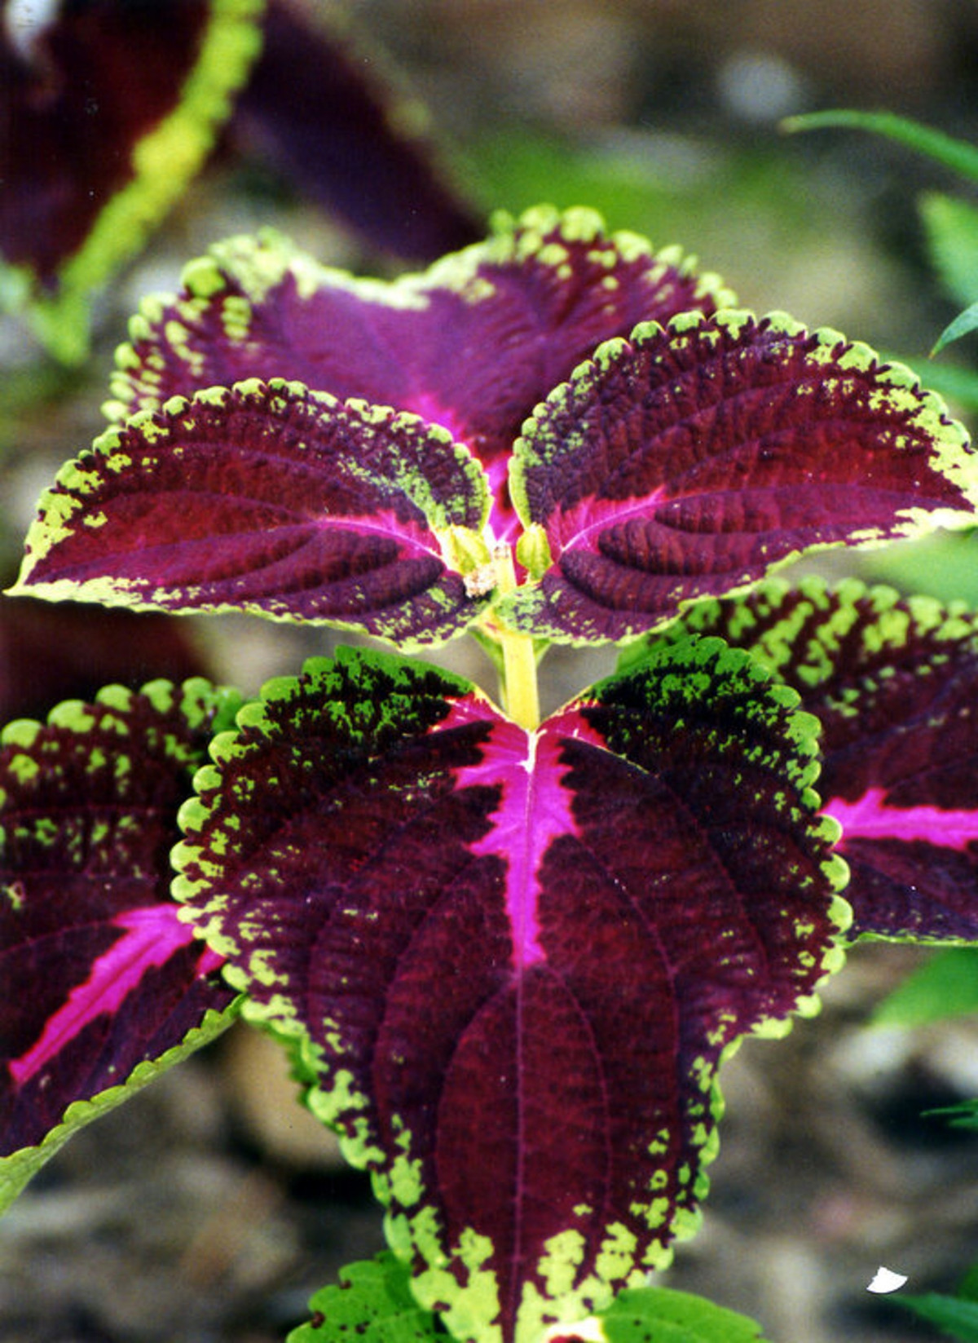
Conclusion
In conclusion, the adoption of advanced techniques for plant disease classification holds immense potential for revolutionizing agricultural practices. By leveraging cutting-edge technologies such as machine learning, remote sensing, and IoT, we can enhance disease diagnosis, improve crop management, and contribute to a more resilient and sustainable agricultural ecosystem.

